Slide 1
Title I Parent Overview workshop
Federal Programs 2022-2023

Slide 2
Title I
What is Title I?
Title I Funds
Title I Plan
Parent Family Engagement Plan
School/Parent/Student Compact
School Improvement Plan

Slide 3
What Is Title I ?
Title I is a federally funded program that provides funds to schools serving high numbers of economically disadvantaged children. Funding for this program is based on the percentage of students attending each school who qualify for free or reduced lunch. The goal is to support schools by providing resources and effective strategies to increase student achievement.

Slide 4
Title I Funds
The purpose of Title I funding is to provide students in areas with a high concentration of children from low-income families significant opportunity to receive a fair, equitable and high‐quality education, and to close educational achievement gaps.
Title I funds are used to provide services that are supplemental or, in addition to, services normally provided by the school for participating children.

Slide 5
Title I Plan
The Title I Plan allows schools to consider federal, state, and local funds when planning their school’s educational program and budget. Schools utilize the school-wide Title I model to implement a systemic and high quality program resulting in increased academic achievement.
Annually, schools are required to review their plans and evaluate the effectiveness of strategies and resources implemented to meet academic goals.

Slide 6
Parent/Family Engagement Plan
Schools develop and implement annual Parent and Family Engagement Plans to support student achievement. Parents are asked to partner with school teams as planners, participants, and decision-makers in the operation of the school-wide Title I program. This partnership is vital in strengthening the program’s ability to meet the needs of all students and support parents’ active commitment to their student’s learning and development in school.

Slide 7
School-Parent-Student Compact
The School-Parent-Student Compact is an agreement between the parent, teacher, and the student. Students have an increased opportunity for success when expectations are clear, consistent, and supported at home. Effective schools are a result of families and educators working together. We encourage you to form a partnership with the school.

Slide 8
School Improvement Plan
The purpose of a School Improvement Plan is to guide the school’s problem-solving and planning process throughout the school year.
The School Improvement Plan helps to identify, organize, and implement strategies and resources that will lead to increased student achievement.
A copy of the School Improvement Plan can be found in the school’s front office or designated area and on the school’s website.

Slide 9
Where Can You Locate Copies of Plans?
School’s Website
School’s Front Office
Title I District Office
Printed copies are available upon request.

Slide 10
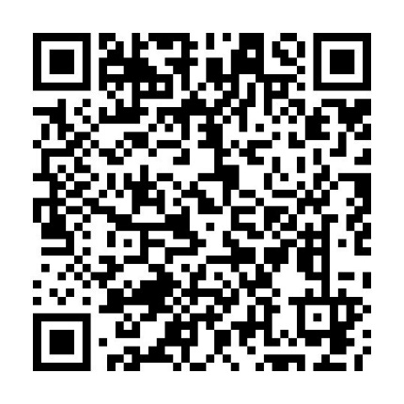
We need your Feedback
Please scan the QR Code or access the link
and give us your feedback!
(A paper copy of this survey is available upon request.)
https://www.papersurvey.io/s/22-23parentengagementinput

